Slide 1
Design and Analysis of Algorithms
Algorithms-II : CS345A
Lecture 18
Dynamic Programming – III
Bitonic Tour
Dynamic Programming and DAG

Slide 2







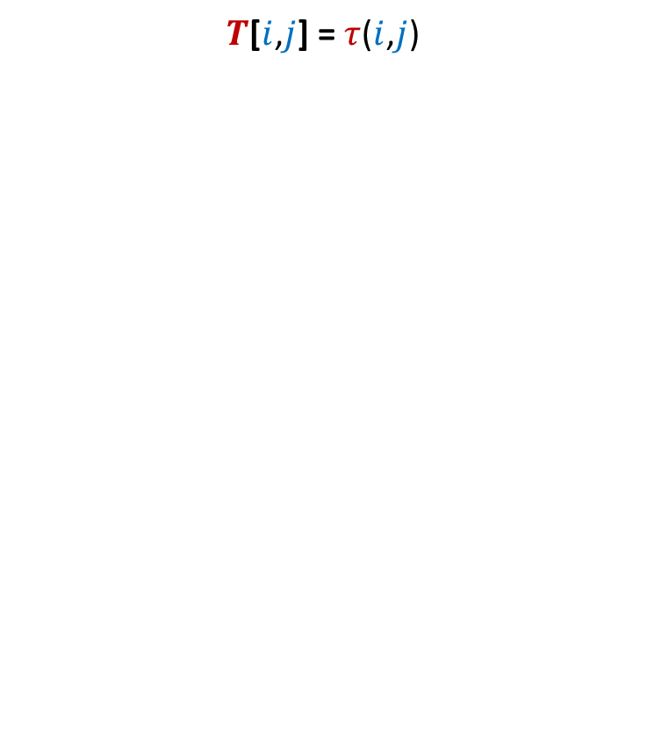

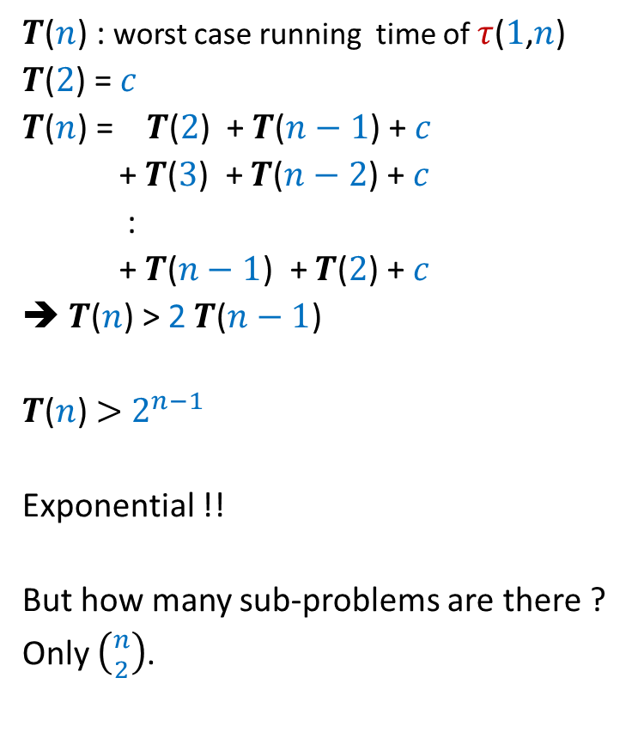

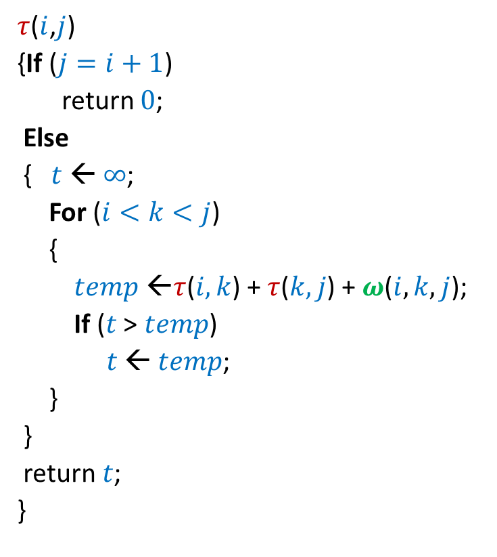
Bitonic tour
There are $n$ points in a plane.
$δ(p_{i},p_{j})$: distance between $p_{i}$ and $p_{j}$
Cost of a tour: Total distance traveled.
$$p_{6}$$
$$p_{2}$$
$$p_{4}$$
$$p_{7}$$
$$p_{10}$$
$$p_{1}$$
$$p_{9}$$
$$p_{11}$$
$$p_{3}$$
$$p_{5}$$
$$p_{8}$$

Slide 3

Bitonic tour
There are $n$ points in a plane.
$δ(p_{i},p_{j})$: distance between $p_{i}$ and $p_{j}$
Problem: Given $n$ points <$p_{1}$,…,$p_{n}$> in increasing $x$-coordinates,
We need to travel from $p_{n}$to $p_{1}$ twice, each time from right to left.
We need to ensure that each intermediate point is visited exactly once.
What is the least distance that needs to be traveled ?
$$p_{6}$$
$$p_{2}$$
$$p_{4}$$
$$p_{7}$$
$$p_{10}$$
$$p_{1}$$
$$p_{9}$$
$$p_{11}$$
$$p_{3}$$
$$p_{5}$$
$$p_{8}$$

Slide 4


New Idea: Generalize the problem
$$p_{6}$$
$$p_{2}$$
$$p_{4}$$
$$p_{7}$$
$$p_{10}$$
$$p_{1}$$
$$p_{n}$$
$$p_{9}$$
$$p_{n+1}$$
$$p_{3}$$
$$p_{5}$$
$$p_{8}$$

Slide 5

New Idea: Generalize the problem
$$p_{6}$$
$$p_{2}$$
$$p_{4}$$
$$p_{7}$$
$$p_{10}$$
$$p_{1}$$
$$p_{n}$$
$$p_{9}$$
$$p_{3}$$
$$p_{8}$$
$$p_{n+1}$$
$$p_{5}$$

Slide 6

New Idea: Generalize the problem
Problem: Given $n+1$ points <$p_{1}$,…,$p_{n+1}$> in increasing $x$-coordinates,
We need to travel from $p_{n}$and $p_{n+1}$ to $p_{1}$
What is the least distance traveled ?
$$p_{6}$$
$$p_{2}$$
$$p_{4}$$
$$p_{7}$$
$$p_{10}$$
$$p_{1}$$
$$p_{n}$$
$$p_{9}$$
$$p_{3}$$
$$p_{8}$$
$$p_{n+1}$$
$$p_{5}$$
traversing each point exclusively once.

Slide 7
What should be the Term for
One parameter or multiple parameters ?
Recursive formulation ?

Slide 8
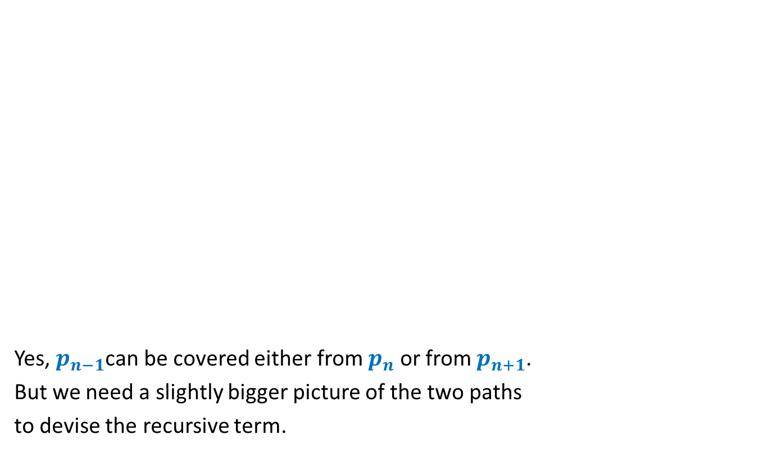


Term for Recursive formulation ?
Yes, $p_{n−1}$can be covered either from $p_{n}$ or from $p_{n+1}$.
But we need a slightly bigger picture of the two paths
to devise the recursive term.
$$p_{n}$$
$$p_{1}$$
$$p_{n+1}$$
$$p_{n−1}$$

Slide 9

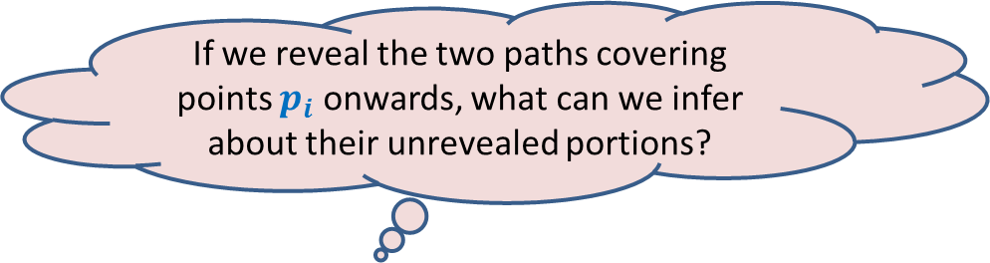





Term for Recursive formulation ?
If we reveal the two paths covering points $p_{i}$ onwards, what can we infer about their unrevealed portions?
Can you see the recursive term that we need ?
$$p_{i}$$
$$p_{n}$$
$$p_{1}$$
$$p_{i−1}$$
$$p_{j}$$
$$p_{n+1}$$
Least dist. travelled to reach $p_{1}$
by two paths from $p_{i}$ and $p_{j}$
covering $p_{2}$,…, $p_{i−1}$exclusively once.

Slide 10
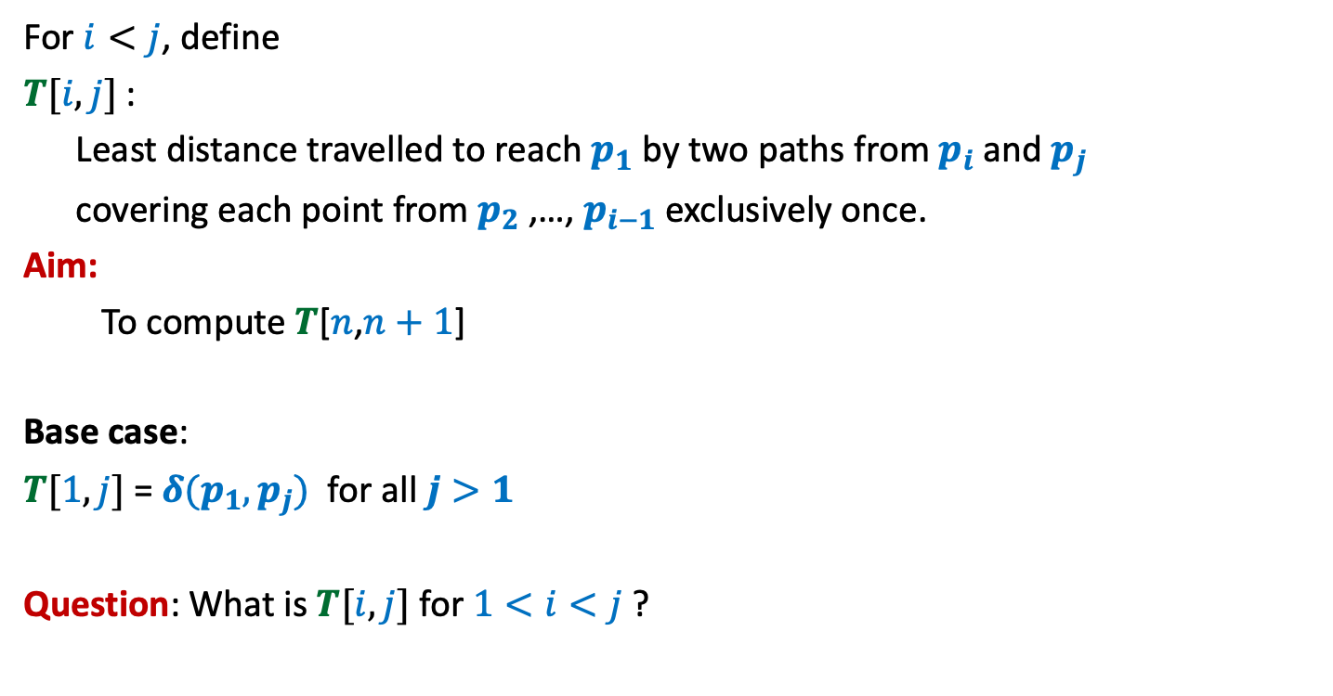
Term for Recursive formulation ?
For $i<j$, define
$T[i,j]$ :
Least distance travelled to reach $p_{1}$ by two paths from $p_{i}$ and $p_{j}$
covering each point from $p_{2}$,…, $p_{i−1}$ exclusively once.
Aim:
To compute $T$[$n$,$n+1$]
Base case:
$T[1,j]$ = $δ(p_{1},p_{j})$ for all $j>1$
Question: What is $T[i,j]$ for $1<i<j$ ?

Slide 11

Recursive formulation for $$T[i,j]$$

Slide 12







Recursive formulation of $T[i,j]$
Two cases:
$p_{i−1}$ visited from $p_{i}$
$p_{i−1}$ visited from $p_{j}$
$T(i,j)$ = $min$($T(i−1,j)$ + $δ(p_{i−1},p_{i})$ , $T(i−1,i)$ + $δ(p_{i−1},p_{j})$)
➔ $T(i,j)$ = $T(i−1,j)$ + $δ(p_{i−1},p_{i})$
➔ $T$($i,j$)= $T(i−1,i)$ + $δ(p_{i−1},p_{j})$
$$p_{i}$$
$$p_{i−1}$$
$$p_{1}$$
$$p_{j}$$

Slide 13
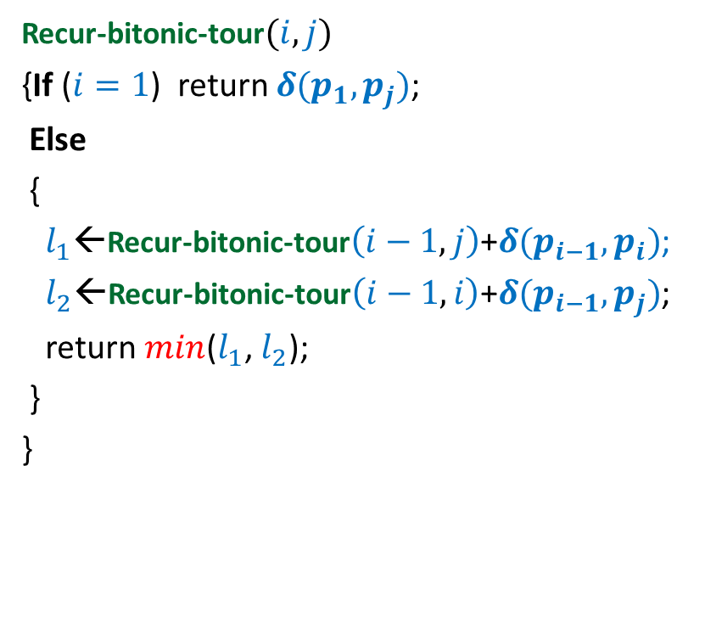

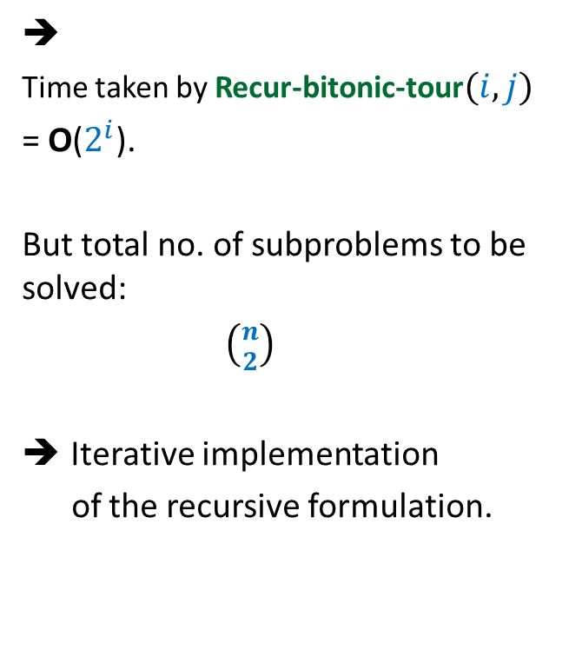
Recursive algorithm for $T(i,j)$
Recur-bitonic-tour$(i,j)$
{If ($i=1$) return $δ(p_{1},p_{j})$;
Else
{
$l_{1}$←Recur-bitonic-tour$\left(i−1,j\right)$+$δ(p_{i−1},p_{i})$;
$l_{2}$←Recur-bitonic-tour$\left(i−1,i\right)$+$δ(p_{i−1},p_{j})$;
return $min$($l_{1}$, $l_{2}$);
}
}
➔
Time taken by Recur-bitonic-tour$(i,j)$
= O($2^{i}$).
But total no. of subproblems to be solved:
$\left({n \atop 2}\right)$
Iterative implementation
of the recursive formulation.

Slide 14






Recursive algorithm for $T(i,j)$
Recur-bitonic-tour$(i,j)$
{If ($i=1$) return $δ(p_{1},p_{j})$;
Else
{
$l_{1}$←Recur-bitonic-tour$\left(i−1,j\right)$+$δ(p_{i−1},p_{i})$;
$l_{2}$←Recur-bitonic-tour$\left(i−1,i\right)$+$δ(p_{i−1},p_{j})$;
return $min$($l_{1}$, $l_{2}$);
}
}
$$n$$
$$i$$
…
2
1
$$i$$
$$j$$
1 2 ... $n+1$
$$T$$

Slide 15
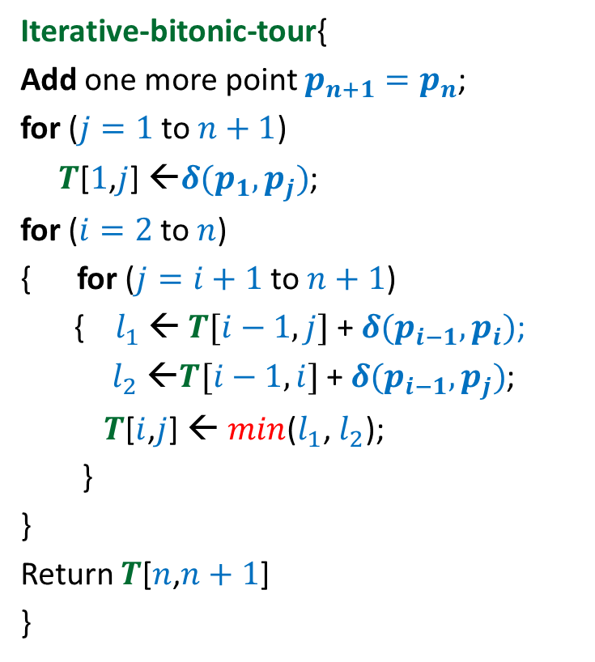


Iterative algorithm for Optimal Bitonic tour
Iterative-bitonic-tour{
Add one more point $p_{n+1}=p_{n}$;
for ($j=1$ to $n+1$)
$T$[$1$,$j$] ←$δ(p_{1},p_{j})$;
for ($i=2$ to $n$)
{ for ($j=i+1$ to $n+1$)
{ $l_{1}$ ← $T[i−1,j]$ + $δ(p_{i−1},p_{i})$;
$l_{2}$ ←$T[i−1,i]$ + $δ(p_{i−1},p_{j})$;
$T$[$i$,$j$] ← $min$($l_{1}$, $l_{2}$);
}
}
Return $T$[$n$,$n+1$]
}
$$n$$
$$i$$
…
2
1
1 2 ... $n+1$
$$j$$
Time complexity: O($n^{2}$)
$$T$$

Slide 16
Lessons learnt
There may be multiple parameter term
hidden in the recursive formulation.
Sometimes generalizaton helps !

Slide 17
Optimal Triangulation of Convex Polygon
Homework from the last class

Slide 18
Recursive algorithm for $τ$($i$,$j$)
$τ$($i$,$j$)
{If ($j=i+1$)
return $0$;
Else
{$t$ ← $∞$;
For ($i<k<j$)
{
$temp$ ←$τ$($i,k$) + $τ$($k,j$) + $ω$($i,k,j$);
If ($t$ > $temp$)
$t$ ← $temp$;
}
}
return $t$;
}

Slide 19


Recursive algorithm for $τ$($i$,$j$)
$T$[$i$,$j$] = $τ$($i$,$j$)
$τ$($i$,$j$)
{If ($j=i+1$)
return $0$;
Else
{$t$ ← $∞$;
For ($i<k<j$)
{
$temp$ ←$τ$($i,k$) + $τ$($k,j$) + $ω$($i,k,j$);
If ($t$ > $temp$)
$t$ ← $temp$;
}
}
return $t$;
}
$$n$$
0
0
0
0
0
0
0
0
0
$$i$$
0
…
0
2
0
1
0
1 2 ... $n$
$$j$$
$$T$$

Slide 20



Iterative algorithm for $τ$($i$,$j$)
$T$[$i$,$j$] = $τ$($i$,$j$)
$$n$$
0
0
0
0
0
0
0
0
0
$$i$$
0
…
0
2
0
$$Δ$$
1
0
$$Δ$$
1 2 ... $n$
$$j$$
$$T$$

Slide 21
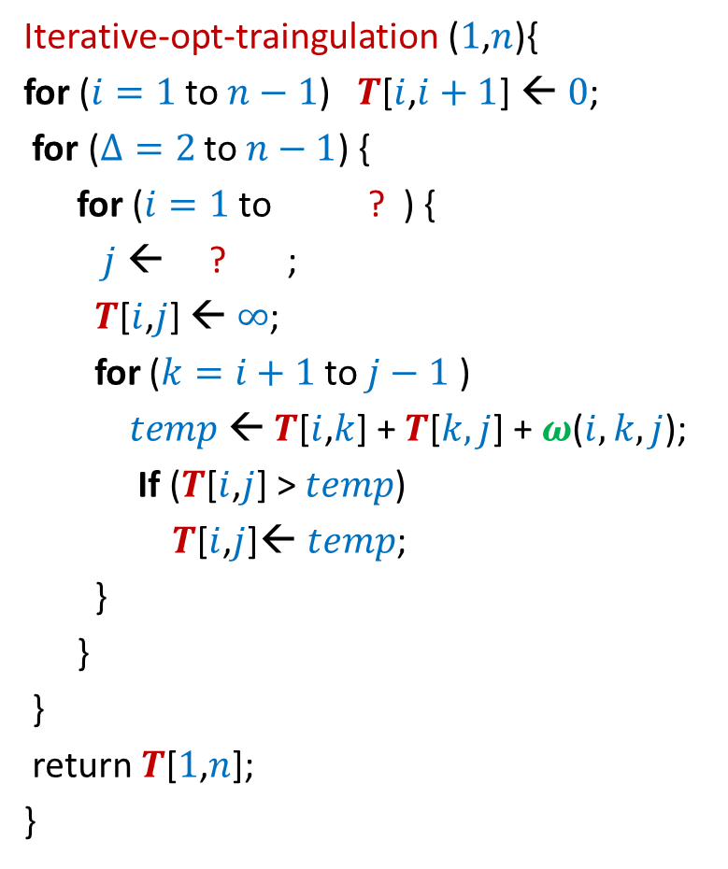


Iterative algorithm for $τ$($i$,$j$)
Iterative-opt-traingulation ($1$,$n$){
for ($i=1$ to $n−1$) $T$[$i$,$i+1$] ← $0$;
for ($Δ=2$ to $n−1$) {
for ($i=1$ to ? ) {
$j$ ← ? ;
$T$[$i$,$j$] ← $∞$;
for ($k=i+1$ to $j−1$ )
$temp$← $T$[$i$,$k$] + $T$[$k,j$] + $ω$($i,k,j$);
If ($T$[$i$,$j$] > $temp$)
$T$[$i$,$j$]← $temp$;
}
}
}
return $T$[$1$,$n$];
}
$T$[$i$,$j$] = $τ$($i$,$j$)
$$n$$
$$n−Δ$$
0
0
$$i+Δ$$
0
0
0
0
$$Δ$$
{
0
0
0
$$i$$
0
…
0
2
0
1
0
$$Δ$$
1 2 ... $n$
$$j$$
$$T$$

Slide 22
Iterative algorithm for $τ$($i$,$j$)
The method of transforming recursive algorithm to iterative algorithm was quite adhoc and tedious.
Can’t we automate it ?
Indeed ☺
We shall transform the recursive algorithm to a suitable problem on a graph.

Slide 23


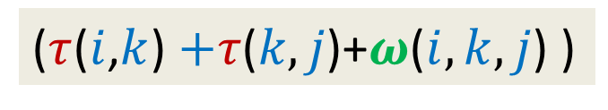










$τ$($i$,$j$) = $\min_{?}{? }$
$Δ=j−i$
($τ$($i$,$k$) $+τ\text{(}k,j\text{)+}ω\text{(}i,k,j\text{)}$ )
$i$<$k$< $j$
What kind of directed graph is it ?
Polygon of $Δ+1$ sides
$τ$($i$,$j$)
DAG
Polygons of $≤Δ$ sides
$τ$($i$,$i+1$)
$τ$($i$,$i+2$)
$τ$($i$,$j−1$)
$τ$($i+1$,$j$)
$τ$($i+2$,$j$)
$τ$($j−1$,$j$)
We always add an edge from a polygon to another polygon of strictly small number of sides
➔ There cannot be any cycle in this graph.☺

Slide 24

$τ$($i$,$j$) = $\min_{?}{? }$
($τ$($i$,$k$) $+τ\text{(}k,j\text{)+}ω\text{(}i,k,j\text{)}$ )
$i$<$k$< $j$
Our aim:
To ensure that all terms that appear in recursive formulation of $τ$($i$,$j$) are evaluated before we evaluate $τ$($i$,$j$).
$τ$($i$,$j$)
How to achieve this aim?
DAG
Topological ordering
Or DFS traversal ☺
$τ$($i$,$i+1$)
$τ$($i$,$i+2$)
$τ$($i$,$j−1$)
$τ$($i+1$,$j$)
$τ$($i+2$,$j$)
$τ$($j−1$,$j$)

Slide 25
Inference
What we discussed works for each dynamic programming based solution.
The reason: Recursion.
Once we have recursive formulation of the Dynamic Programming based solution,
we can suitably define a problem on DAG
And solve it using topological ordering or DFS ☺
Description of the DAG:
Nodes: the instances of the problem
Outgoing Edges of a node: number of terms in the recursive formulation
Homework: Internalize this generic method fully.

